Slide 1
Body Parts

Slide 2



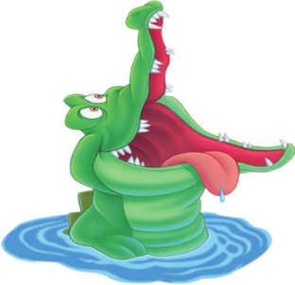


Reward System
Student’s score:
Teacher’s score:
is for student
is for teacher
Teacher Directions (TD): 1. If student (S) answers correctly, he/she goes up on the ladder. If not, the teacher (T) goes up. 2. If S doesn’t follow the classroom rules, he/she goes down. 3. The one who saves the most people is the winner. 4. T draws the reward system on the whiteboard or paper to use throughout class.

Slide 3
Head, Shoulders, Knees and Toes
Head and shoulders knees and toes Knees and toes Head and shoulders knees and toes Knees and toes And eyes and ears And mouth and nose Head and shoulders knees and toes Knees and toes
TD: T teachers S the song “Head, Shoulder, Knees and Toes” with physical movements.

Slide 4


Let’s Begin
nose
TD: S says the vocabulary word and uses it in a sentence.

Slide 5

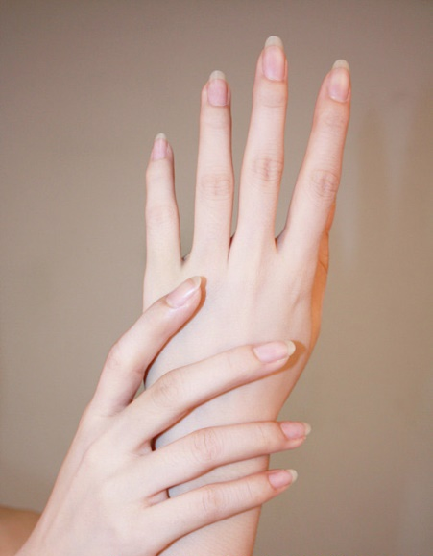
hand
hands

Slide 6

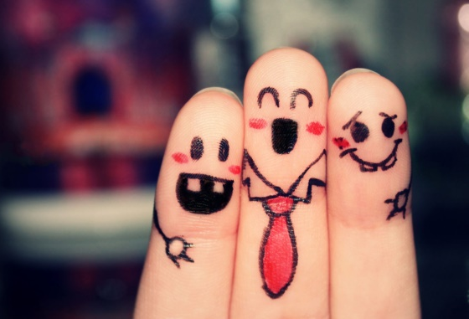
finger
fingers

Slide 7

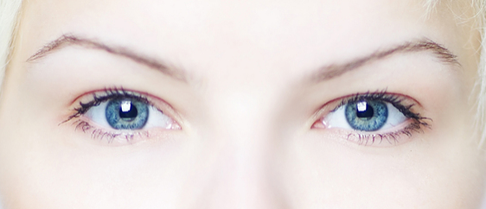
eye
eyes

Slide 8

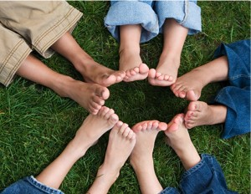
foot
feet

Slide 10
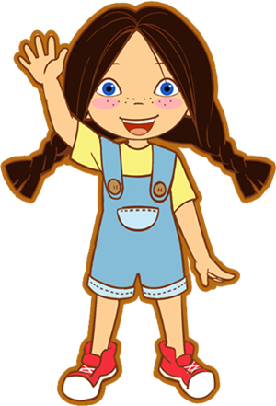
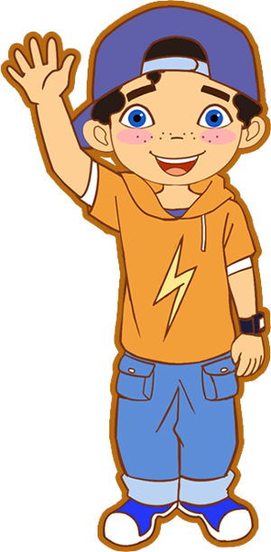
What’s missing?
TD: S identifies the missing body part and uses this vocabulary in a complete sentence.

Slide 11


TD: S identifies the missing body part and uses this vocabulary in a complete sentence. Extension: “Where did it go? Where is your nose? Where is my nose? Touch your nose…” etc.

Slide 12
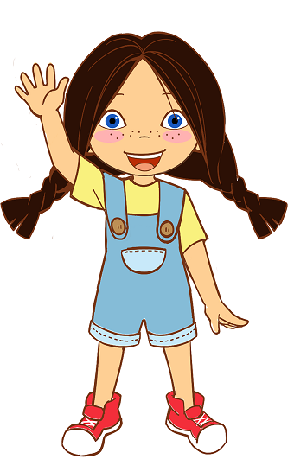
TD: : S identifies the missing body part and uses the vocabulary in a complete sentence. Extension: “Where did they go? Where are your hands/feet? Where are my hands/feet? Touch your feet… Show me your hands” etc.

Slide 13

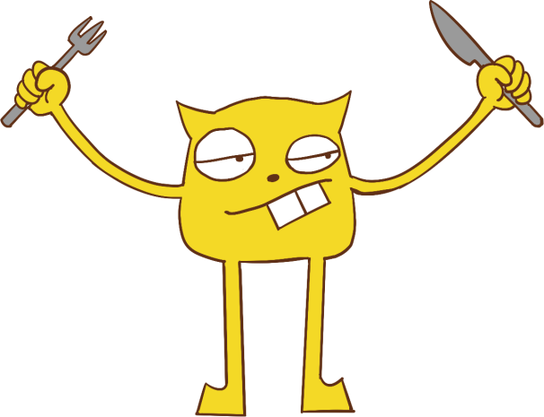
Draw and Talk
TD: S can use the picture on the left bottom as a referenceto draw the missing body parts of the monster. S tells T what they are drawing as they draw it.

Slide 14
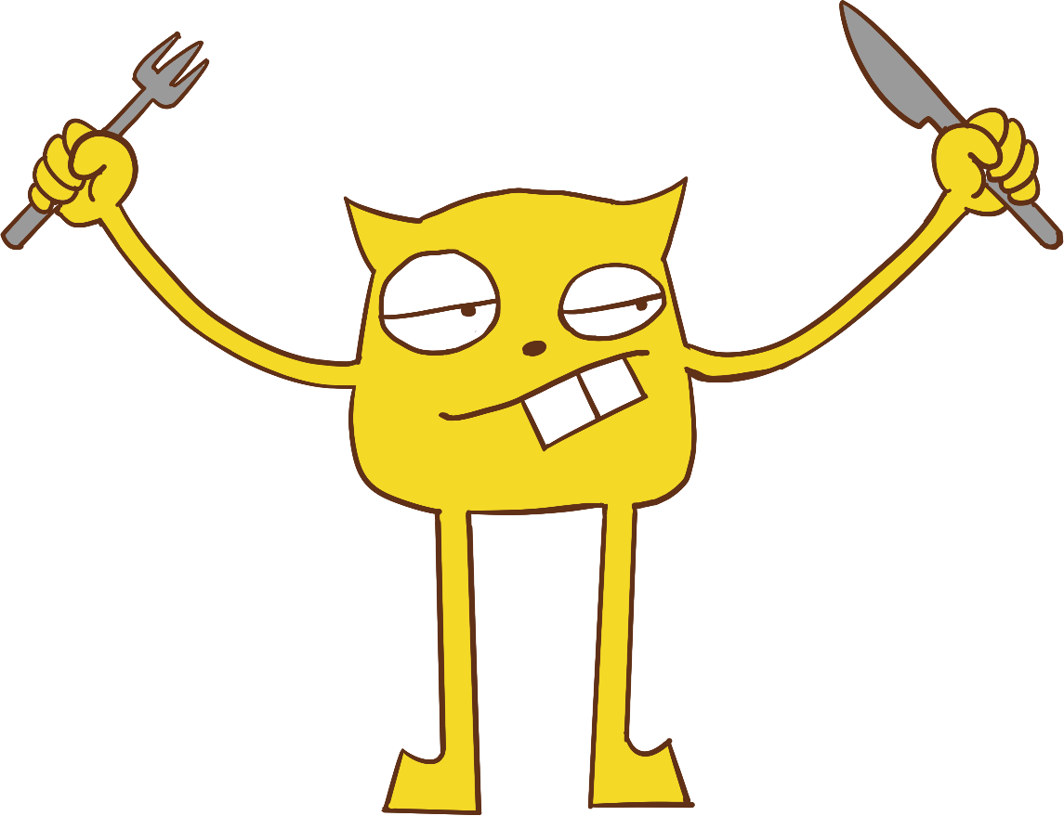
Match and Say
eye
eyes
finger
fingers
nose
nose
hand
hands
foot
feet
TD: T circles and reads the words one by one. Then ask S to match the words with the monster’s body parts by drawing lines.

Slide 15
I Say, You Do
TD: T tells the student to do as the T does. T begins by both saying and demonstrating each step, asking the student to repeat the word and action. After completing several rounds, T says the command without demonstrating. When the S can play the game on their own successfully, reward using the reward system. Extension: Switch roles.

Slide 16

TD: T prompts S to describe the body parts S sees in the picture.

Slide 17

Goodbye boy/girl,
Goodbye boy/girl,
See you next time!
Goodbye boy/girl,
Goodbye boy/girl,
See you next time!
(Tune of Jingle Bells)
Notes:
Added commas

